Slide 1
PGS
New Member Orientation
Version: 1.1
Updated: Nov 29, 2007

Slide 2
Agenda
Brief Introduction
PGS Team
To-do list
Suggestions

Slide 3
Project introduction
What is eBusiness Financial Gateway?
  credit card processing
  real-time authorization
  integrate with payment and risk management.
What is the counterpart team?
  eCommerce Services - Finance Gateway Team, Houston
Who is our customer?
  Hp Shopping, ePrime,
  CitiGlobal, American Express
'HP Restricted'
Notes:
Budget cuts were ‘de rigueur’.
Employees had to re-think the way they work.
HP/Compaq merger was a key impetus of change.
Rationalization, consolidation and integration were needed immediately!
More than one hundred storefronts existed.
Consolidation was mandatory.
Consolidation required simultaneous revision of front and
back-end systems.
Tight coupling would cause repetitive reworking.
An eclectic collection of technologies existed.
Rationalization and integration were required.
Continue to meet business objectives
Systems had to remain operational during the change period.
Presentation Title

Slide 4
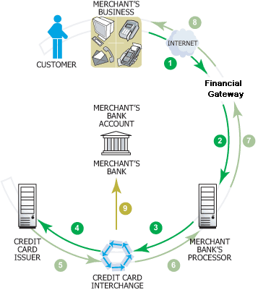
Brief Introduction

Slide 5
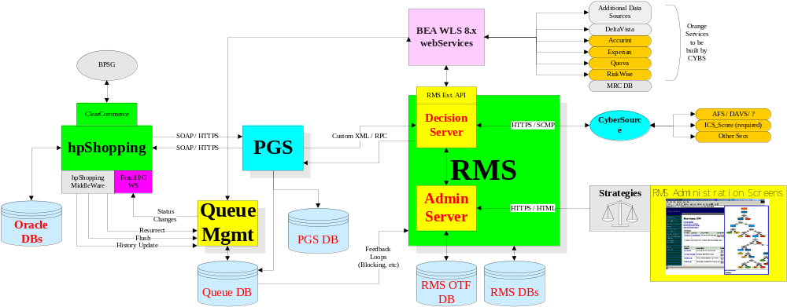
Brief Introduction - architecture

Slide 6
PGS Team
US PGS Team
<<Project Manager>>
Andrews, Greg
<<Solution Architect>>
Mao, Jiaxi
<<Service Manager>>
Eveleth, Deborah
China Dev Team
<<Project Lead>>
Ji, Li-Chun (Spring)
<<Solution Architect>>
Mayor, Christopher
<<Service Manager>>
Fernandez, Jennifer R.
<<Tech Lead –
Admin Tool>>
Zhu, Jin
<<Tech Lead –
PGS WS>>
Chen, Yang (Charlie)
Support Team
<<Tech Lead –
Recon/Msg Bus>>
Yuan, Hong (Evan)
<<Support Manager>>
Taira, Paul
<<.NET Dev>>
Shui, Tian-Yi
<<Support Lead>>
D, Kamalakkannan
<<.NET Dev>>
Shen, Lin
<<.NET Dev>>
Wu, Zhao-Ming
<<Java Dev>>
Wang, Shu-Wen
<<Java Dev>>
Lai, Fei

Slide 7
To-do List - New to ECO IT
Grant access to ECO IT team site -
Contact: Li Yue
http://gdcckm.chn.hp.com/teams/ams/ECOIT/default.aspx
Read through NEO slides under
http://gdcckm.chn.hp.com/teams/ams/ECOIT/New%20Employee%20Orientation/Forms/AllItems.aspx
Apply TeamPlay account, http://primavera.corp.hp.com/
Scroll down to last. Fill out Primavera Logon Request Forms. Contact support if you have issues.

Slide 8
To-do List – New to PGS project
Setup TeamPlay activities
  Training material http://na2.know.hp.com/teams/ecoit_tt/default.aspx
  TeamPlay http://ccetplwspr.cce.hp.com/en/index.html
  Contact: Spring/Jiaxi/Chris
  /add by lai fei
  http://primavera.corp.hp.com/
  Scroll down to last. Fill out Primavera Logon Request Forms. Contact support if you have issues, then they will reply your call service and give you account and password later.
Join dev email group PGS-Dev-China
  Contact: Spring/Jim
Setup VSS System
  Location: \\hickwall.chn.hp.com\d$\VSS
  Contact: Charlie

Slide 9
To-do List
Setup CVS System
  Apply for account http://ux14229.chn.hp.com/MYSCM/common/login.jsp
    user name: NT account w/o domain
    Password: click “forget password” to get password by email
    Contact: Zhang, Jian-He
  Add to PGS CVS domain
    Contact: Spring
Get access permission of China team portal http://gdcckm.chn.hp.com/teams/itmb/pp/hpit/EIEFG/default.aspx
Contact: Spring
Update personal info (http://gdcckm.chn.hp.com/teams/itmb/pp/hpit/EIEFG/Lists/Team%20Members/AllItems.aspx)
Get access permission of US portal http://na.know.hp.com/teams/CWS/default.aspx
  Contact: Spring/Greg

Slide 10
Suggestions
For planned leave
  Contact tech lead and Spring before submit online application
  athp.hp.com >> Benefits, Careers & Policies >> Personal Information >>假期申请与查询
  Add event to team portal http://gdcckm.chn.hp.com/teams/itmb/pp/hpit/EIEFG/default.aspx
  The day before leave
    Send out email to PGS-Dev-China
    Setup Outlook Auto-reply (optional)
For sick leave
  Contact tech lead and Spring

